Slide 1
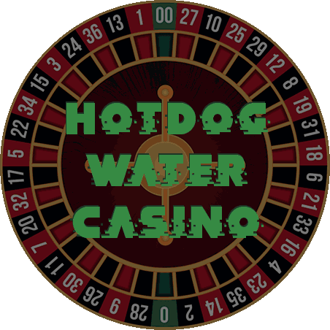
Gambling Team 2: Electric Boogaloo

Slide 2
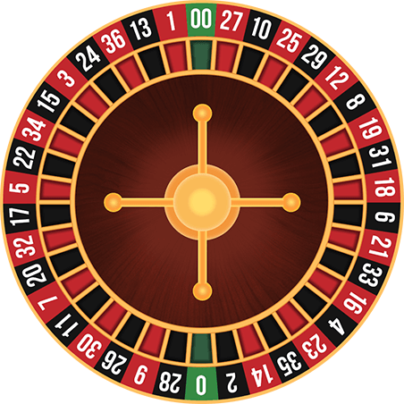


Team
Jaiden Hawkins
Sam Williams

Slide 3
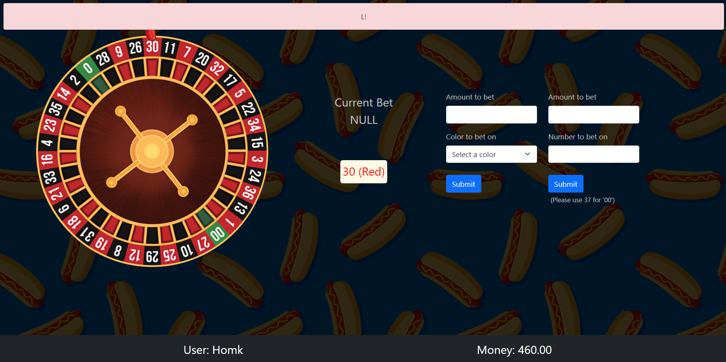
Problem
We understand that many people have boredom. Our goal is to provide users with a convenient way to gamble. It could also be used as a party game or for events.

Slide 4
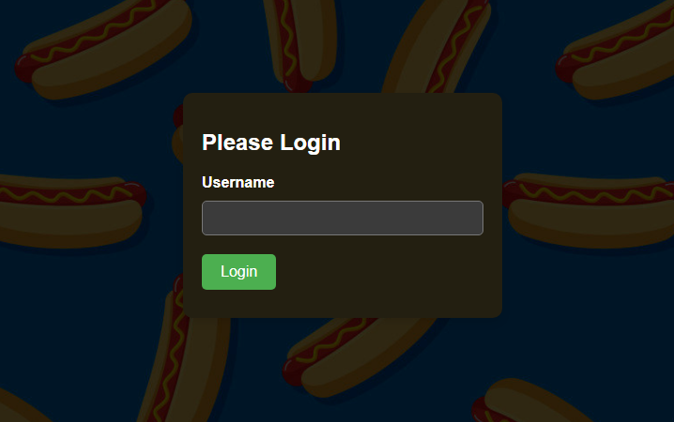
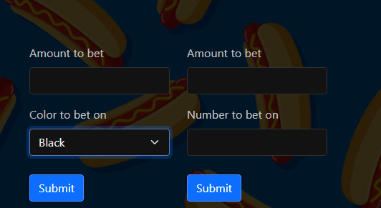
Solution
We solved this problem by creating a roulette wheel game where you can bet fake credit and earn your bets back. Users will be able to create a profile name that will be tied to their credits.

Slide 5
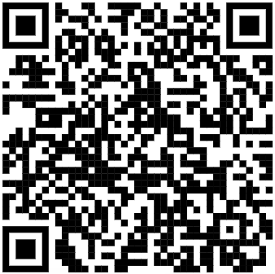
Demo

Slide 6
Lessons Learned
If a page is password protected it can be easily found if the variables are simply named.
Planning thing out is very useful.

Slide 7
Issues/Bugs
Going straight to the roulette page will crash the web page.
Spinning the wheel before reset causes it to spin funky.
Users are able to spin the wheel themselves.
Webhooks need to be fixed everytime the instance is stopped

Slide 8
Future Versions
We could improve security on the password.
Lock the spin button on the admin page until its ready again.
Prevent users from being able to spin the wheel themselves.

Slide 9
Questions?

